Slide 1
Simple Calculator using Tkinter library
A Python GUI Application
-Nivedita Patil

Slide 2
Introduction:
In this presentation we see how a GUI calculator
is created using Tkinter library.
This calculator performs an arithmetic and scientific operations and also features a GUI with buttons used for numerical digits and scientific operations.

Slide 3
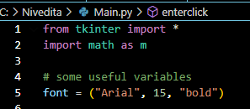

Import Library and Initialize function:
Import ‘Tkinter’ library as “tk” and ‘Math’ library as m.
Create the main window using window= Tk().
Set the title using window.title().
Set the dimension length of the application using window.geometry().

Slide 4
Some important functions:
Click (back): It deletes the last digit given by the user in the text field.
Click (clear): It clears the input/expression given by the user in the text field.
Click (Mode): It helps to switch the calculator from a normal mode to a scientific mode.

Slide 5
Creating buttons:
Buttons for Normal Calculator: Create buttons from (0-9) and (=, /, *, +, -, .)
Buttons for Scientific Calculator: Create buttons such as (sqrt, pow, fact, rad, deg, sin, cos, tan).
Bind all the above buttons using “bind” function.
Use “grid” function to organize all buttons in a proper layout.

Slide 6

Main loop function:
Use “window.mainloop()” to start the Tkinter event loop.
This helps to keep the application running and responsive to user input until it is closed.

Slide 7
Conclusion:
We have created a simple GUI calculator using Tkinter library which is very user friendly.
This project helped me to learn coding in visual studio code.
It also helped me to know about Tkinter library and Python.

Slide 8
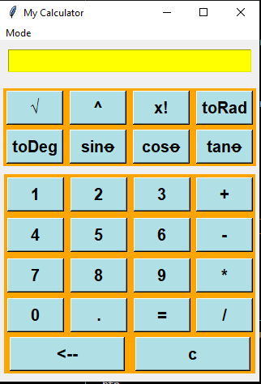
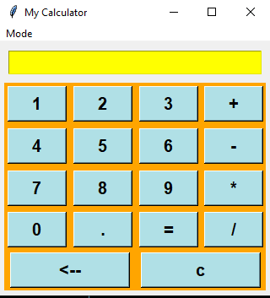
Two modes of calculator:
Normal mode
Scientific mode

Slide 9
thank you

